Slide 1
Lesson 1:
Kotlin basics

Slide 2
About this lesson
Lesson 1: Kotlin basics
Get started
Operators
Data types
Variables
Conditionals
Lists and arrays
Null safety
Summary

Slide 3
Get started

Slide 4
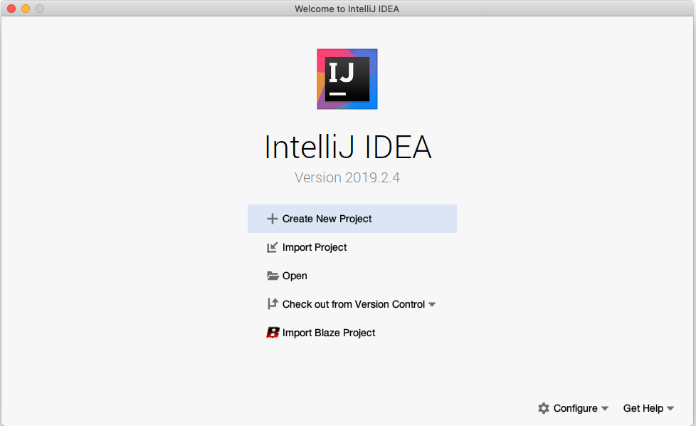
Open IntelliJ IDEA

Slide 5
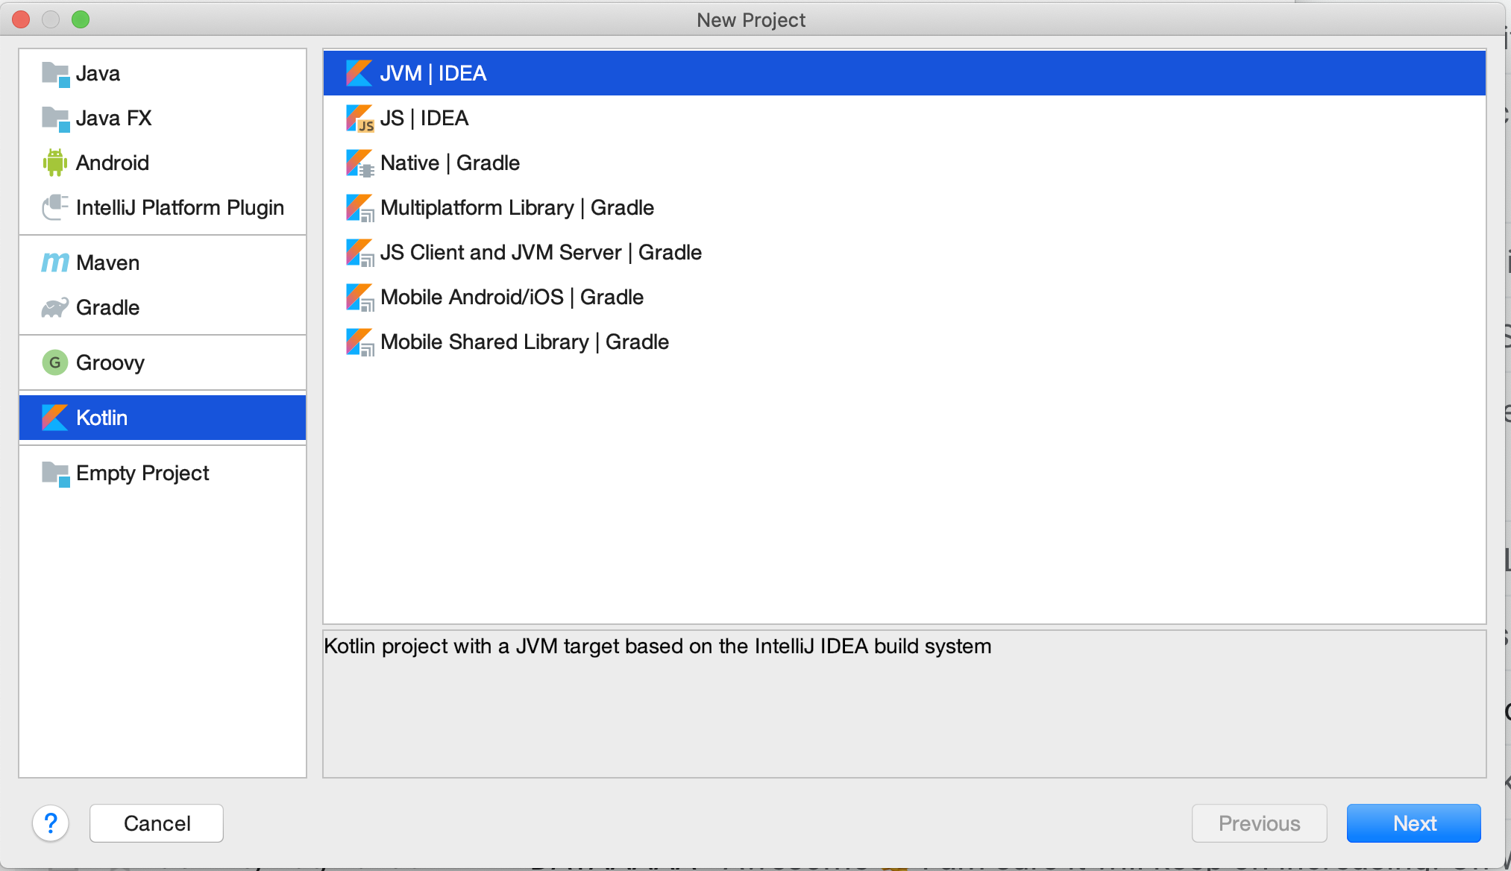
Create a new project

Slide 6
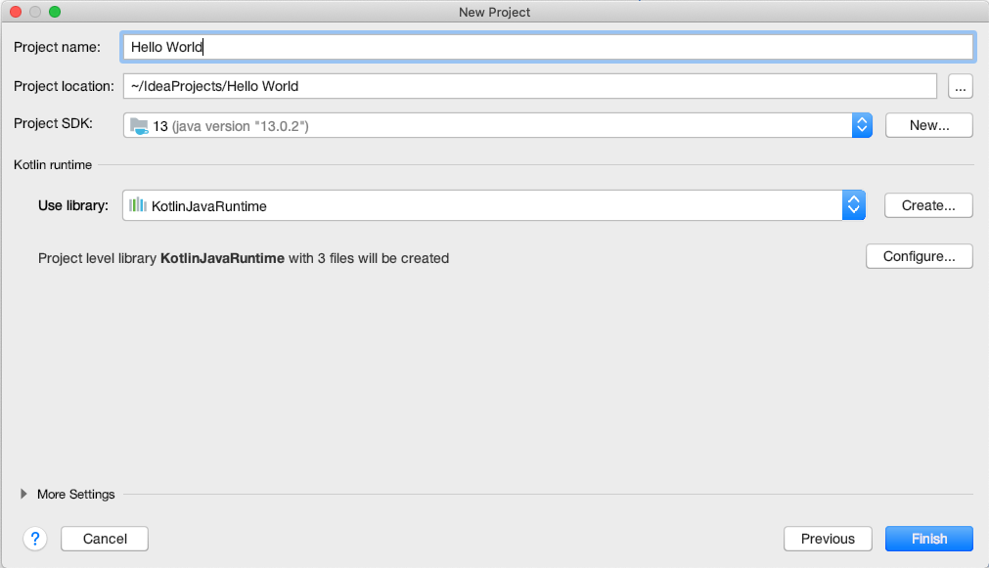
Name the project

Slide 7
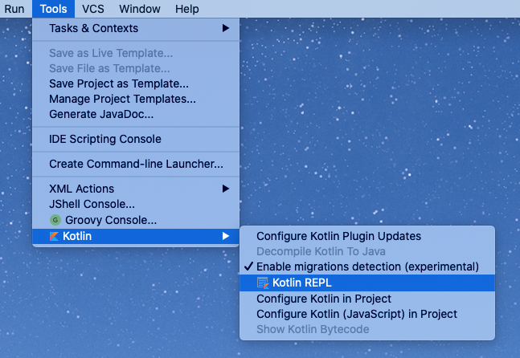
Open REPL (Read-Eval-Print-Loop)
It may take a few moments before the Kotlin menu appears under Tools.

Slide 8
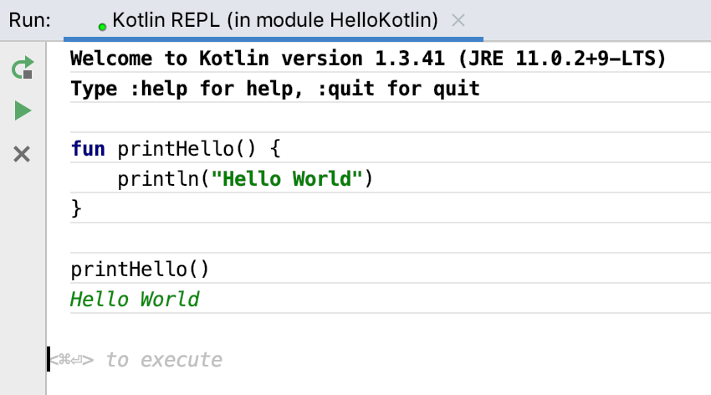
Create a printHello() function
Press Control+Enter (Command+Enter on a Mac) to execute.

Slide 9
Operators

Slide 10
Operators
- * / %
Mathematical operators
++ --
Increment and decrement operators
< <= > >=
Comparison operators
=
Assignment operator
== !=
Equality operators

Slide 11
Math operators with integers
1 + 1 =>
2
53 - 3 =>
50
50 / 10 =>
5
9 % 3 =>
0

Slide 12
Math operators with doubles
1.0 / 2.0 =>
0.5
2.0 * 3.5 =>
7.0

Slide 13
Math operators
1+1
⇒ kotlin.Int = 2
1.0/2.0
⇒ kotlin.Double = 0.5
53-3
⇒ kotlin.Int = 50
2.0*3.5
⇒ kotlin.Double = 7.0
⇒ indicates output from your code.
Result includes the type (kotlin.Int).
50/10
⇒ kotlin.Int = 5

Slide 14
Numeric operator methods
Kotlin keeps numbers as primitives, but lets you call methods on numbers as if they were objects.
2.times(3)
⇒ kotlin.Int = 6
3.5.plus(4)
⇒ kotlin.Double = 7.5
2.4.div(2)
⇒ kotlin.Double = 1.2

Slide 15
Data types

Slide 16
Integer types
Type | Bits | Notes
Long | 64 | From -2⁶³ to 2⁶³-1
Int | 32 | From -2³¹ to 2³¹-1
Short | 16 | From -32768 to 32767
Byte | 8 | From -128 to 127

Slide 17
Floating-point and other numeric types
Type | Bits | Notes
Double | 64 | 16 - 17 significant digits
Float | 32 | 6 - 7 significant digits
Char | 16 | 16-bit Unicode character
Boolean | 8 | True or false. Operations include: || - lazy disjunction, && - lazy conjunction, ! - negation

Slide 18
Operand types
Results of operations keep the types of the operands
6*50
⇒ kotlin.Int = 300
1/2
⇒ kotlin.Int = 0
6.0*50.0
⇒ kotlin.Double = 300.0
1.0*2.0
⇒ kotlin.Double = 0.5
6.0*50
⇒ kotlin.Double = 300.0

Slide 19
Type casting
Assign an Int to a Byte
val i: Int = 6
val b: Byte = i
println(b)
⇒ error: type mismatch: inferred type is Int but Byte was expected
Convert Int to Byte with casting
val i: Int = 6
println(i.toByte())
⇒ 6

Slide 20
Underscores for long numbers
Use underscores to make long numeric constants more readable.
val oneMillion = 1_000_000
val idNumber = 999_99_9999L
val hexBytes = 0xFF_EC_DE_5E
val bytes = 0b11010010_01101001_10010100_10010010

Slide 21
Strings
Strings are any sequence of characters enclosed by double quotes.
val s1 = "Hello world!"
String literals can contain escape characters
val s2 = "Hello world!\n"
Or any arbitrary text delimited by a triple quote (""")
val text = """
var bikes = 50
"""

Slide 22
String concatenation
val numberOfDogs = 3
val numberOfCats = 2
"I have $numberOfDogs dogs" + " and $numberOfCats cats"
=> I have 3 dogs and 2 cats

Slide 23
String templates
A template expression starts with a dollar sign ($) and can be a simple value:
val i = 10
println("i = $i")
=> i = 10
Or an expression inside curly braces:
val s = "abc"
println("$s.length is ${s.length}")
=> abc.length is 3

Slide 24
String template expressions
val numberOfShirts = 10
val numberOfPants = 5
"I have ${numberOfShirts + numberOfPants} items of clothing"
=> I have 15 items of clothing

Slide 25
Variables

Slide 26
Variables
Powerful type inference
Let the compiler infer the type
You can explicitly declare the type if needed
Mutable and immutable variables
Immutability not enforced, but recommended
Kotlin is a statically-typed language. The type is resolved at compile time and never changes.

Slide 27
Specifying the variable type
Colon Notation
var width: Int = 12
var length: Double = 2.5
Important: Once a type has been assigned by you or the compiler, you can't change the type or you get an error.

Slide 28
Mutable and immutable variables
Mutable (Changeable)
var score = 10
Immutable (Unchangeable)
val name = "Jennifer"
Although not strictly enforced, using immutable variables is recommended in most cases.

Slide 29
var and val
var count = 1
count = 2
val size = 1
size = 2
=> Error: val cannot be reassigned

Slide 30
Conditionals

Slide 31
Control flow
Kotlin features several ways to implement conditional logic:
If/Else statements
When statements
For loops
While loops

Slide 32
if/else statements
val numberOfCups = 30
val numberOfPlates = 50
if (numberOfCups > numberOfPlates) {
println("Too many cups!")
} else {
println("Not enough cups!")
}
=> Not enough cups!

Slide 33
if statement with multiple cases
val guests = 30
if (guests == 0) {
println("No guests")
} else if (guests < 20) {
println("Small group of people")
} else {
println("Large group of people!")
}
⇒ Large group of people!

Slide 34
Ranges
Data type containing a span of comparable values (e.g., integers from 1 to 100 inclusive)
Ranges are bounded
Objects within a range can be mutable or immutable

Slide 35
Ranges in if/else statements
val numberOfStudents = 50
if (numberOfStudents in 1..100) {
println(numberOfStudents)
}
=> 50
Note: There are no spaces around the "range to" operator (1..100)

Slide 36
when statement
when (results) {
0 -> println("No results")
in 1..39 -> println("Got results!")
else -> println("That's a lot of results!")
}
⇒ That's a lot of results!
As well as a when statement, you can also define a when expression that provides a return value.

Slide 37
for loops
val pets = arrayOf("dog", "cat", "canary")
for (element in pets) {
print(element + " ")
}
⇒ dog cat canary
You don’t need to define an iterator variable and increment it for each pass.

Slide 38
for loops: elements and indexes
for ((index, element) in pets.withIndex()) {
println("Item at $index is $element\n")
}
⇒ Item at 0 is dog
Item at 1 is cat
Item at 2 is canary

Slide 39
for loops: step sizes and ranges
for (i in 1..5) print(i)
⇒ 12345
for (i in 5 downTo 1) print(i)
⇒ 54321
for (i in 3..6 step 2) print(i)
⇒ 35
for (i in 'd'..'g') print (i)
⇒ defg

Slide 40
while loops
var bicycles = 0
while (bicycles < 50) {
bicycles++
}
println("$bicycles bicycles in the bicycle rack\n")
⇒ 50 bicycles in the bicycle rack
do {
bicycles--
} while (bicycles > 50)
println("$bicycles bicycles in the bicycle rack\n")
⇒ 49 bicycles in the bicycle rack

Slide 41
repeat loops
repeat(2) {
print("Hello!")
}
⇒ Hello!Hello!

Slide 42
Lists and arrays

Slide 43
Lists
Lists are ordered collections of elements
List elements can be accessed programmatically through their indices
Elements can occur more than once in a list
An example of a list is a sentence: it's a group of words, their order is important, and they can repeat.

Slide 44
Immutable list using listOf()
Declare a list using listOf() and print it out.
val instruments = listOf("trumpet", "piano", "violin")
println(instruments)
⇒ [trumpet, piano, violin]

Slide 45
Mutable list using mutableListOf()
Lists can be changed using mutableListOf()
val myList = mutableListOf("trumpet", "piano", "violin")
myList.remove("violin")
⇒ kotlin.Boolean = true
With a list defined with val, you can't change which list the variable refers to, but you can still change the contents of the list.

Slide 46
Arrays
Arrays store multiple items
Array elements can be accessed programmatically through their indices
Array elements are mutable
Array size is fixed

Slide 47
Array using arrayOf()
An array of strings can be created using arrayOf()
val pets = arrayOf("dog", "cat", "canary")
println(java.util.Arrays.toString(pets))
⇒ [dog, cat, canary]
With an array defined with val, you can't change which array the variable refers to, but you can still change the contents of the array.

Slide 48
Arrays with mixed or single types
An array can contain different types.
val mix = arrayOf("hats", 2)
An array can also contain just one type (integers in this case).
val numbers = intArrayOf(1, 2, 3)

Slide 49
Combining arrays
Use the + operator.
val numbers = intArrayOf(1,2,3)
val numbers2 = intArrayOf(4,5,6)
val combined = numbers2 + numbers
println(Arrays.toString(combined))
=> [4, 5, 6, 1, 2, 3]

Slide 50
Null safety

Slide 51
Null safety
In Kotlin, variables cannot be null by default
You can explicitly assign a variable to null using the safe call operator
Allow null-pointer exceptions using the !! operator
You can test for null using the elvis (?:) operator

Slide 52
Variables cannot be null
In Kotlin, null variables are not allowed by default.
Declare an Int and assign null to it.
var numberOfBooks: Int = null
⇒ error: null can not be a value of a non-null type Int

Slide 53
Safe call operator
The safe call operator (?), after the type indicates that a variable can be null.
Declare an Int? as nullable
var numberOfBooks: Int? = null
In general, do not set a variable to null as it may have unwanted consequences.

Slide 54
Testing for null
Check whether the numberOfBooks variable is not null. Then decrement that variable.
var numberOfBooks = 6
if (numberOfBooks != null) {
numberOfBooks = numberOfBooks.dec()
}
Now look at the Kotlin way of writing it, using the safe call operator.
var numberOfBooks = 6
numberOfBooks = numberOfBooks?.dec()

Slide 55
The !! operator
If you’re certain a variable won’t be null, use !! to force the variable into a non-null type. Then you can call methods/properties on it.
val len = s!!.length
throws NullPointerException if s is null
Warning: Because !! will throw an exception, it should only be used when it would be exceptional to hold a null value.

Slide 56
Elvis operator
Chain null tests with the ?: operator.
numberOfBooks = numberOfBooks?.dec() ?: 0
The ?: operator is sometimes called the "Elvis operator," because it's like a smiley on its side with a pompadour hairstyle, like Elvis Presley styled his hair.

Slide 57
Summary

Slide 58
Summary
In Lesson 1, you learned how to:
Create an IntelliJ IDEA project, opening REPL, and execute a function
Use operators and numeric operator methods
Use data types, type casting, strings, and string templates
Use variables and type inference, and mutable and immutable variables
Use conditionals, control flow, and looping structures
Use lists and arrays
Use Kotlin's null safety features

Slide 59

Pathway
Practice what you’ve learned by completing the pathway:
Lesson 1: Kotlin basics

